Slide 1
PROFITABILITY CALCULATIONS

Slide 2
Price Overview - Service

Slide 3
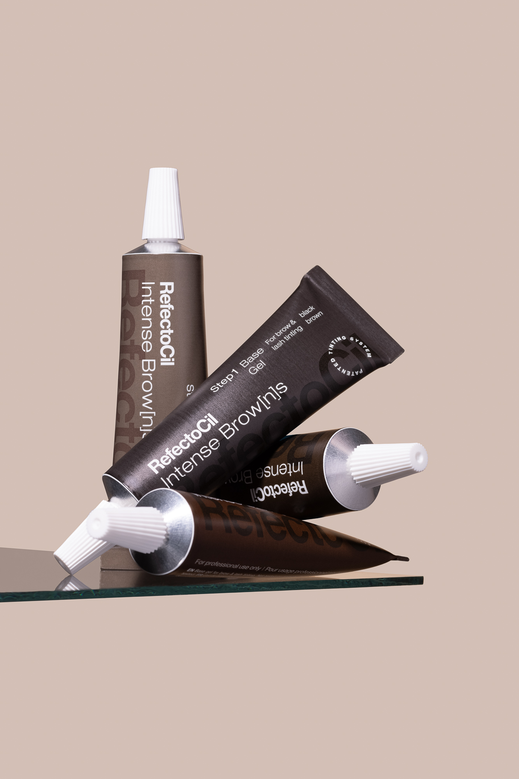
Profitability Calculation
Please note that the number of applications mentioned in these calculations serve as a guidance to illustrate how many applications can be done from one product. Please note that the actual numbers may differ from the applications mentioned in this presentation since it depends on the actual usage of the professional.
Notes:
All to dos when it comes to the product itself have been finalized. We are in the process of producing the tubes, the kits, the folders so that we are ready for September. We have also been busy compiling the marketing launch kit, here you can see the most important to dos for the launch, e.g. advertising campaign, launch presentation. Social Media Content Box, Image Videos a.s.f. Further, a big pillar of this launch is the Academy & Training. We are in the process of finalizing German and English tutorial videos, shorter clips for youtube and also the training presentations that keep Marina very busy at the moment.

Slide 4
Eyebrow Intensifying Service
Profitability
Service: ~25-30 minutes Salon Revenue: $40.00
You can achieve ~15-20* tinting services with ONLY one tube!
Salon Purchase Price:
1x Intensifying Primer: $16.95 = ~ 15 - 20 applications
1x Base Gel: $16.95 = ~ 15 - 20 applications
1x Activator Gel: $29.95 = ~15 applications
1x Tint remover Intense Brow[n]s: $29.95 = ~ 60 applications = Total cost: $93.80
Additional profit with little effort
Increased customer satisfaction
Customer loyalty
Cost per service (for salon):
Intensifying Primer: $1.13 Base Gel: $1.13
Activator Gel: $2.00
Tint remover remover Intense Brow[n]s : $0.50
Total cost for one treatment: $4.76
Revenue with one tube = $600 - $800
Optimize your service by adding Eyecare Pads or Care Balm
*Depends on the quantity which is needed for one service

Slide 5
Eyelash Intensifying Service
Profitability
Service: ~15-20 minutes Salon Revenue: $20.00
You can achieve ~15-20* tinting services with ONLY one tube!
Salon Purchase Price:
1x Base Gel: $16.95 = ~15-20 applications
1x Activator Gel: $29.95 = ~15 applications
1x Tint remover Intense Brow[n]s: $29.95 = ~ 60 applications = Total cost: $76.85
Additional profit with little effort
Increased customer satisfaction
Customer loyalty
Cost per service (for salon): Base Gel: $1.13
Activator Gel: $2.00
Tint remover remover Intense Brow[n]s : $0.50
Total cost for one treatment: $3.63
Revenue with one tube = $300 - $400
Optimize your service by adding Eyecare Pads or Care Balm
*Depends on the quantity which is needed for one service

Slide 6
PROFESSIONAL KIT INTENSE BROW[N]S
Profitability
Salon Purchase Price:
1 Kit = 60 applications = Total cost: $299.95
1 Kit includes:
1x Brow Mapper
2x 15ml Intensifying Primer Medium
2x 15ml Intensifying Primer Strong
1x 15ml Base Gel Ash Brown
1x 15ml Base Gel Chocolate Brown
1x 15ml Base Gel Deep Brown
1x 15ml Base Gel Black Brown
4x 15ml Activator Gel
1x 150ml Tint Remover Intense Browns
2x Cosmetic Brushes
2x Cosmetic Dishes
Service: ~25 – 30 minutes
You can achieve ~60 tinting services with ONLY Kit!
Cost per service (for salon): Total cost for one treatment: $5.00
Perfect tool to start with the Intense Browns
Additional profit with little effort
Increased customer satisfaction
Customer loyalty
Revenue with one Kit = $2,400
60x applications with one Kit: 60x $40= $2,400

Slide 7
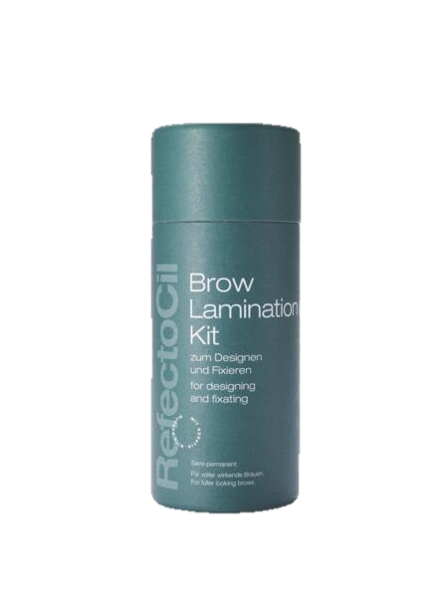
Combo: Brow Lamination + Tint
Profitability
Service: ~ 60 - 90 minutes Salon Revenue: $100
You can achieve ~15-20 tinting services with ONLY one tube!
Salon Purchase Price:
1x Brow Lamination Kit: $124.95 = 15 applications
1x Intensifying Primer: $16.95 = 15 - 20 applications
1x Base Gel: $16.95 = 15 - 20 applications
1x Activator Gel: $29.95 = 15 applications
1x Tint remover Intense Brow[n]s: $29.95 = 60 applications = Total cost: $218.75
Additional profit with little effort
Increased customer satisfaction
Customer loyalty
Cost per service (for salon):
Brow Lamination: $8.33
Intensifying Primer: $1.13 Base Gel: $1.13
Activator Gel: $2.00
Tint remover remover Intense Brow[n]s : $0.50
Total cost for one treatment: $13.09
Revenue with 1 Kit + one tube = $1,650
15x Brow Lamination applications*$70 = $1050 + ($40*15 applications) = $1,650

Slide 8
Overview of the number of applications
Overview
1 Primer: ~15 - 20 applications
1 Base Gel: ~15 - 20 applications
1 Activator: ~15 applications
1 Tint remover: ~60 applications
1 Saline Solution: ~60 applications
1 Micellar Eye Make-Up remover: ~60 applications
Care Balm: ~50 applications
Styling Gel: ~60 applications
Booster: ~100 applications ~ (for 3 months if being used once a day)
Skin protection cream: ~80 applications
Brow & Lash Foam: ~40 applications

